Slide 1
Military Technical Academy
Principles of Programming Language
Names, Bindings, Type Checking, and Scopes

Slide 2
Topics
Introduction
Names
Variables
The Concept of Binding
Type Checking
Strong Typing
Type Equivalence
Scope
Scope and Lifetime
Referencing Environments
Named Constants

Slide 3
Introduction
Imperative languages are abstractions of von Neumann architecture
  Memory
  Processor
Variables characterized by attributes
  To design a type, must consider scope, lifetime, type checking, initialization, and type compatibility

Slide 4
Names
Design issues for names:
  Are names case sensitive?
  Are special words reserved words or keywords?

Slide 5
Names (continued)
Length
  If too short, they cannot be connotative
  Language examples:
    FORTRAN I: maximum 6
    COBOL: maximum 30
    FORTRAN 90 and C89: maximum 31
    C99: maximum 63
    C#, Ada, and Java: no limit, and all are significant
    C++: no limit, but implementers often impose one

Slide 6
Names (continued)
Case sensitivity
  Disadvantage: readability (names that look alike are different)
    Names in the C-based languages are case sensitive
    Names in others are not
    Worse in C++, Java, and C# because predefined names are mixed case (e.g. IndexOutOfBoundsException)

Slide 7
Names (continued)
Special words
  An aid to readability; used to delimit or separate statement clauses
    A keyword is a word that is special only in certain contexts, e.g., in Fortran
      Real VarName (Real is a data type followed with a name, therefore Real is a keyword)
      Real = 3.4 (Real is a variable)
  A reserved word is a special word that cannot be used as a user-defined name
  Potential problem with reserved words: If there are too many, many collisions occur (e.g., COBOL has 300 reserved words!)

Slide 8
Variables
A variable is an abstraction of a memory cell
Variables can be characterized as a sextuple of attributes:
  Name
  Address
  Value
  Type
  Lifetime
  Scope

Slide 9
Variables Attributes
Name - not all variables have them
Address - the memory address with which it is associated
  A variable may have different addresses at different times during execution
  A variable may have different addresses at different places in a program
  If two variable names can be used to access the same memory location, they are called aliases
  Aliases are created via pointers, reference variables, C and C++ unions
  Aliases are harmful to readability (program readers must remember all of them)

Slide 10
Variables Attributes (continued)
Type - determines the range of values of variables and the set of operations that are defined for values of that type; in the case of floating point, type also determines the precision
Value - the contents of the location with which the variable is associated
  The l-value of a variable is its address
  The r-value of a variable is its value
Abstract memory cell - the physical cell or collection of cells associated with a variable

Slide 11
The Concept of Binding
A binding is an association, such as between an attribute and an entity, or between an operation and a symbol
Binding time is the time at which a binding takes place.

Slide 12
Possible Binding Times
Language design time -- bind operator symbols to operations
Language implementation time-- bind floating point type to a representation
Compile time -- bind a variable to a type in C or Java
Load time -- bind a C or C++ static variable to a memory cell)
Runtime -- bind a nonstatic local variable to a memory cell

Slide 13
Possible Binding Times
C assignment statement:
  count = count + 5
  The type of count is bound at compile time
  The set of possible values of count is bound at cimpiler design time
  The meaning of the operator + is bound at compile time, when the types of its operands have been determined.
  The internal representation of the literal 5 is bound at compiler design time
  The value of count is bound at execution time with this statement

Slide 14
Static and Dynamic Binding
A binding is static if it first occurs before run time and remains unchanged throughout program execution.
A binding is dynamic if it first occurs during execution or can change during execution of the program

Slide 15
Type Binding
How is a type specified?
When does the binding take place?
If static, the type may be specified by either an explicit or an implicit declaration

Slide 16
Explicit/Implicit Declaration
An explicit declaration is a program statement used for declaring the types of variables
An implicit declaration is a default mechanism for specifying types of variables (the first appearance of the variable in the program)
FORTRAN, PL/I, BASIC, and Perl provide implicit declarations
  Advantage: writability
  Disadvantage: reliability (less trouble with Perl)

Slide 17
Dynamic Type Binding
Dynamic Type Binding (JavaScript and PHP)
Specified through an assignment statement e.g., JavaScript
list = [2, 4.33, 6, 8];
list = 17.3;
  Advantage: flexibility (generic program units)
  Disadvantages:
    High cost (dynamic type checking and interpretation)
    Type error detection by the compiler is difficult

Slide 18
Type Inference
Type Inferencing (ML, Miranda, and Haskell)
  Rather than by assignment statement, types are determined (by the compiler) from the context of the reference
Storage Bindings & Lifetime
  Allocation - getting a cell from some pool of available cells
  Deallocation - putting a cell back into the pool
The lifetime of a variable is the time during which it is bound to a particular memory cell

Slide 19
Storage Bindings & Lifetime
Storage Bindings & Lifetime
  Allocation - getting a cell from some pool of available cells
  Deallocation - putting a cell back into the pool
The lifetime of a variable is the time during which it is bound to a particular memory cell

Slide 20
Categories of Variables by Lifetimes
Static--bound to memory cells before execution begins and remains bound to the same memory cell throughout execution, e.g., C and C++ static variables
  Advantages: efficiency (direct addressing), history-sensitive subprogram support
  Disadvantage: lack of flexibility (no recursion)

Slide 21
Categories of Variables by Lifetimes
Stack-dynamic--Storage bindings are created for variables when their declaration statements are elaborated. (A declaration is elaborated when the executable code associated with it is executed)
If scalar, all attributes except address are statically bound
  local variables in C subprograms and Java methods
Advantage: allows recursion; conserves storage
Disadvantages:
  Overhead of allocation and deallocation
  Subprograms cannot be history sensitive
  Inefficient references (indirect addressing)

Slide 22
Categories of Variables by Lifetimes
Explicit heap-dynamic -- Allocated and deallocated by explicit directives, specified by the programmer, which take effect during execution
Referenced only through pointers or references, e.g. dynamic objects in C++ (via new and delete), all objects in Java
Advantage: provides for dynamic storage management
Disadvantage: inefficient and unreliable

Slide 23
Categories of Variables by Lifetimes
Explicit heap-dynamic
C++ code segment
int *intnode; //Create a pointer
…
intnode = new int; //Create the heap-dynamic variable
…
delete intnode; //Deallocate the heap-dynamic variable
//to which intnode points

Slide 24
Categories of Variables by Lifetimes
Implicit heap-dynamic--Allocation and deallocation caused by assignment statements
  all variables in APL; all strings and arrays in Perl, JavaScript, and PHP
  e.g., JavaScript
  heighs = [74, 84, 86, 90, 71]
Advantage: flexibility (generic code)
Disadvantages:
  Inefficient, because all attributes are dynamic
  Loss of error detection

Slide 25
Type Checking
Generalize the concept of operands and operators to include subprograms and assignments
Type checking is the activity of ensuring that the operands of an operator are of compatible types
A compatible type is one that is either legal for the operator, or is allowed under language rules to be implicitly converted, by compiler- generated code, to a legal type
  This automatic conversion is called a coercion.
A type error is the application of an operator to an operand of an inappropriate type

Slide 26
Type Checking (continued)
If all type bindings are static, nearly all type checking can be static
If type bindings are dynamic, type checking must be dynamic
A programming language is strongly typed if type errors are always detected
Advantage of strong typing: allows the detection of the misuses of variables that result in type errors

Slide 27
Strong Typing
Language examples:
  FORTRAN 95 is not: parameters, EQUIVALENCE
  C and C++ are not: parameter type checking can be avoided; unions are not type checked
  Ada is, almost (UNCHECKED CONVERSION is loophole)
  (Java and C# are similar to Ada)

Slide 28
Strong Typing (continued)
Coercion rules strongly affect strong typing--they can weaken it considerably (C++ versus Ada)
Although Java has just half the assignment coercions of C++, its strong typing is still far less effective than that of Ada

Slide 29
Name Type Equivalence
Name type equivalence means the two variables have equivalent types if they are in either the same declaration or in declarations that use the same type name
Easy to implement but highly restrictive:
  Subranges of integer types are not equivalent with integer types
  Formal parameters must be the same type as their corresponding actual parameters

Slide 30
Variable Attributes: Scope
The scope of a variable is the range of statements over which it is visible
The nonlocal variables of a program unit are those that are visible but not declared there
The scope rules of a language determine how references to names are associated with variables

Slide 31
Static Scope
Based on program context
To connect a name reference to a variable, you (or the compiler) must find the declaration
Search process: search declarations, first locally, then in increasingly larger enclosing scopes, until one is found for the given name
Enclosing static scopes (to a specific scope) are called its static ancestors; the nearest static ancestor is called a static parent
Some languages allow nested subprogram definitions, which create nested static scopes (e.g., Ada, JavaScript, and PHP)

Slide 32
Blocks
Allowing new static scopes to be defined in the midst of executable code
Introduced in ALGOL 60, allows a section of code to have its own local variables whose scope is minimized.
Such variables are typically stack dynamic, so they have their storage allocated when the section is entered and deallocated when the section exited.
Such a section of code is called a block.

Slide 33
Blocks
Examples:
C-based languages:
while (...) {
int index;
...
}
Ada:
declare Temp : Float;
begin
...
end

Slide 34
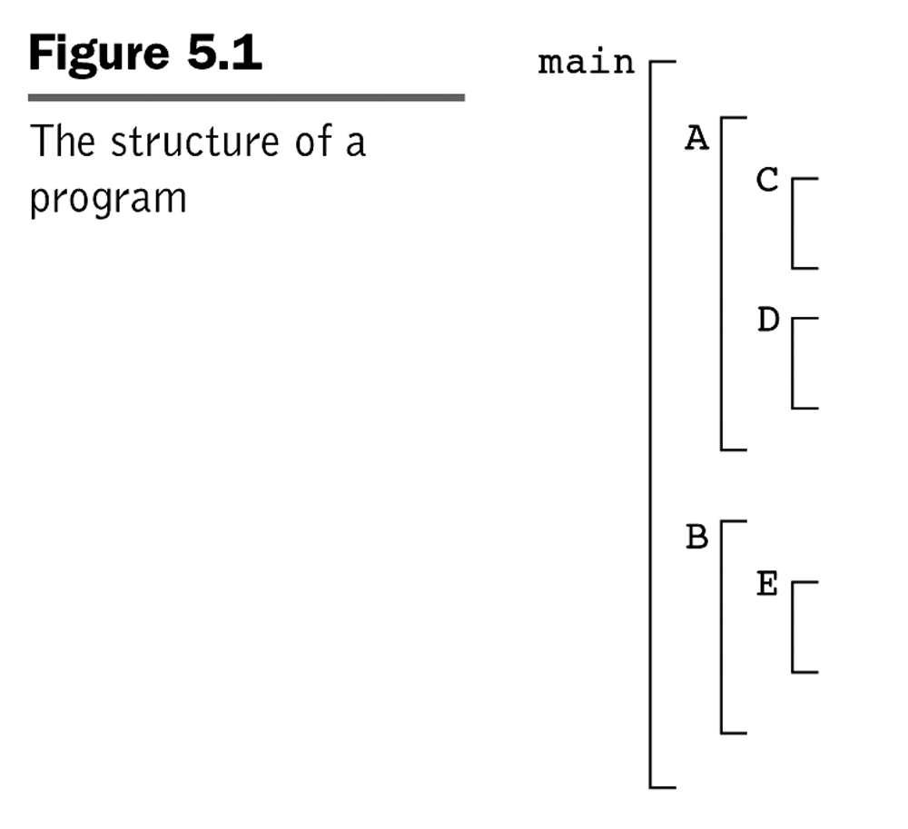
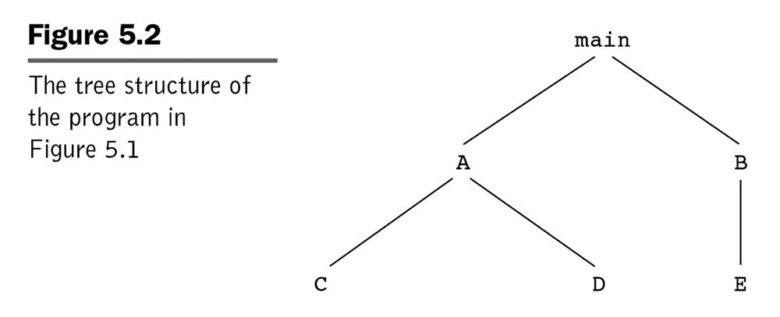
Evaluation of Static Scoping
Assume MAIN calls A and B
  A calls C and D
  B calls A and E

Slide 35
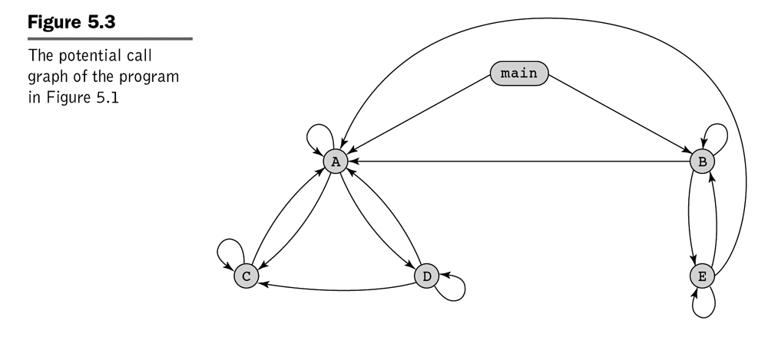
Static Scope Example

Slide 36
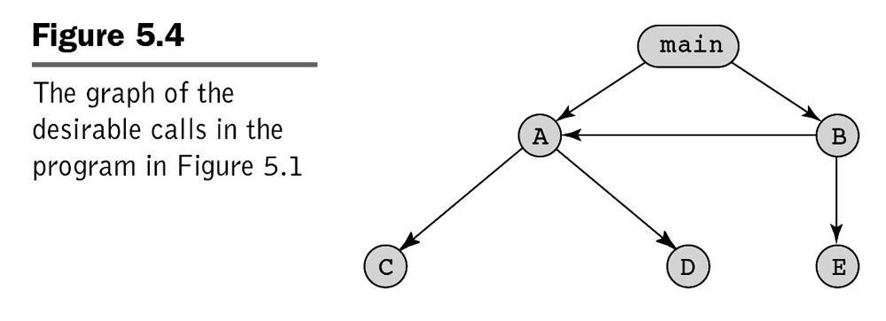
Static Scope Example

Slide 37
Static Scope (continued)
Suppose the spec is changed so that D must now access some data in B
Solutions:
  Put D in B (but then C can no longer call it and D cannot access A's variables)
  Move the data from B that D needs to MAIN (but then all procedures can access them)
Same problem for procedure access
Overall: static scoping often encourages many globals

Slide 38
Dynamic Scope
Based on calling sequences of program units, not their textual layout (temporal versus spatial)
References to variables are connected to declarations by searching back through the chain of subprogram calls that forced execution to this point

Slide 39
Scope Example
Big
declaration of X
Sub1
- declaration of X -
...
call Sub2
...
Sub2
...
- reference to X -
...
...
call Sub1
…
Big calls Sub1
Sub1 calls Sub2
Sub2 uses X

Slide 40
Scope Example
Static scoping
  Reference to X is to Big's X
Dynamic scoping
  Reference to X is to Sub1's X
Evaluation of Dynamic Scoping:
  Advantage: convenience (called subprogram is executed in the context of the caller)
  Disadvantage: poor readability

Slide 41
Scope and Lifetime
Scope and lifetime are sometimes closely related, but are different concepts
Consider a static variable in a C or C++ function
  Void printheader() {
  …
  } /*end of printheader */
  Void compute() {
  int sum;
  …
  printheader ();
  } /*end of compute */

Slide 42
Scope and Lifetime
Scope and lifetime are sometimes closely related, but are different concepts
Consider a static variable in a C or C++ function
  Void printheader() {
  …
  } /*end of printheader */
  Void compute() {
  int sum;
  …
  printheader ();
  } /*end of compute */
The scope of the variable sum is completely contained within the compute function. It does not extend to the body of the function printheader, although printheader executes in the midst of the execution of compute

Slide 43
Scope and Lifetime
Scope and lifetime are sometimes closely related, but are different concepts
Consider a static variable in a C or C++ function
  Void printheader() {
  …
  } /*end of printheader */
  Void compute() {
  int sum;
  …
  printheader ();
  } /*end of compute */
The life time of sum extends over the time during which printheader executes.

Slide 44
Referencing Environments
The referencing environment of a statement is the collection of all names that are visible in the statement
In a static-scoped language, it is the local variables plus all of the visible variables in all of the enclosing scopes
A subprogram is active if its execution has begun but has not yet terminated
In a dynamic-scoped language, the referencing environment is the local variables plus all visible variables in all active subprograms

Slide 45
Named Constants
A named constant is a variable that is bound to a value only when it is bound to storage
Advantages: readability and modifiability
Used to parameterize programs
The binding of values to named constants can be either static (called manifest constants) or dynamic
Languages:
  FORTRAN 95: constant-valued expressions
  Ada, C++, and Java: expressions of any kind
  C# has two kinds, readonly and const
  - the values of const named constants are bound at
  compile time
  - The values of readonly named constants are
  dynamically bound

Slide 46
Variable Initialization
The binding of a variable to a value at the time it is bound to storage is called initialization
Initialization is often done on the declaration statement, e.g., in Java
int sum = 0;

Slide 47
Summary
Case sensitivity and the relationship of names to special words represent design issues of names
Variables are characterized by the sextuples: name, address, value, type, lifetime, scope
Binding is the association of attributes with program entities
Scalar variables are categorized as: static, stack dynamic, explicit heap dynamic, implicit heap dynamic
Strong typing means detecting all type errors

